Slide 1
Today’s Agenda
Designing of digital circuits using NAND and NOR gates.
XOR and XNOR gates
Even parity generator and checker circuit design using XOR gates.

Slide 2
NAND and NOR Implementations
NAND and NOR gates are universal gates.
Using NAND gate we can implement NOT,AND and OR gates.
Similarly using NOR gate we can implement NOT, AND and OR gate.
We want to implement digital circuits using NAND and NOR gates as they are easier to fabricate than AND OR and NOT gates.
Therefore we want to implement Boolean functions using either NAND gates or NOR gates.

Slide 3
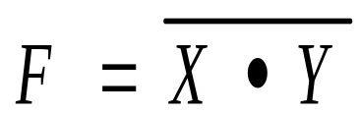
NAND Gate function
NOT-AND function
Input |  | Output
X | Y | F
0 | 0 | 1
0 | 1 | 1
1 | 0 | 1
1 | 1 | 0
38

Slide 4
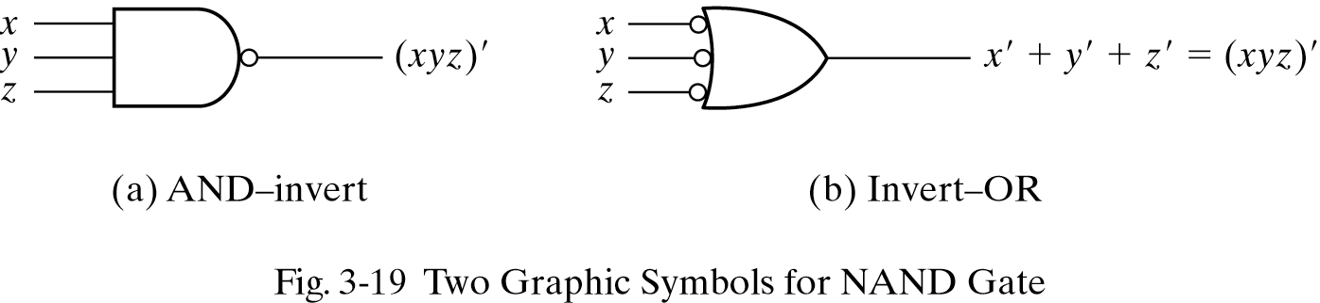
Graphical Representation of NAND Gate:
39

Slide 5
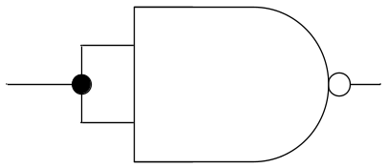
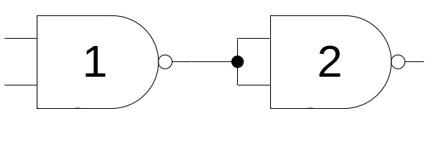
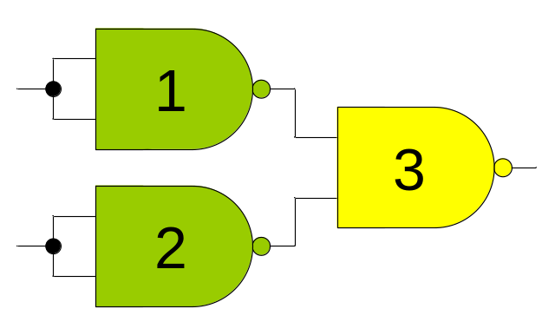
Implementation of NOT, AND and OR Gate Using NAND Gate:
NOT Gate
AND Gate
OR Gate
40

Slide 6
NAND: 2 Level Implementation Procedure:
Simplify the function and express it in standard SOP.
Draw the NAND gate for each product term.
Draw the single gate using AND-invert or invert-OR symbol for sum term.
A term with single literal, complement if needed.
41

Slide 7
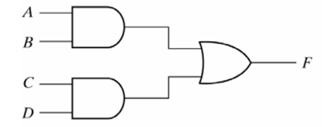
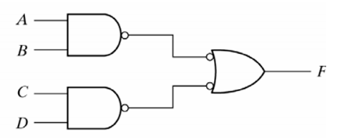
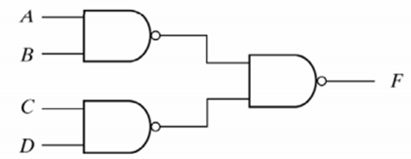
Example:
F= AB +CD
42

Slide 8
Multilevel NAND Circuits
Represent the Boolean function into multilevel AND-OR diagram.
Convert all AND gate to NAND gates.
Convert OR gates to NAND gates with invert-OR symbol.
Balance all bubbles, insert inverter if needed.
43

Slide 9
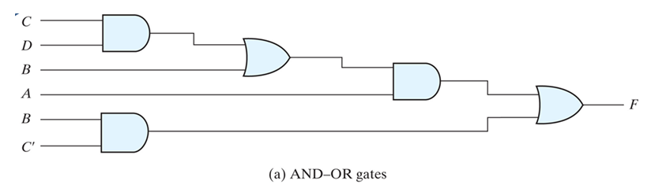
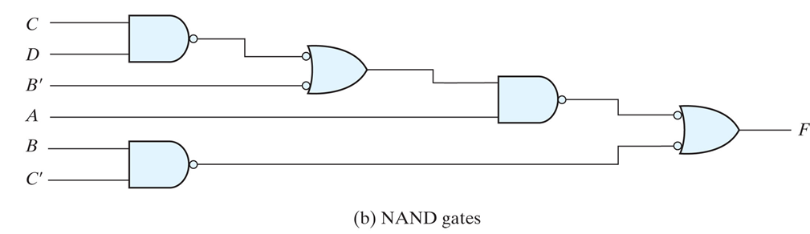
Conversion of Multi-level Logic to NAND Gates
F = A (B + C D) + B C'

Slide 10
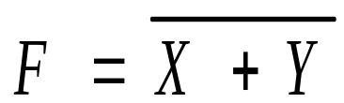
NOR Gate function
OR-NOT function
Input |  | Output
X | Y | F
0 | 0 | 1
0 | 1 | 0
1 | 0 | 0
1 | 1 | 0
45

Slide 11
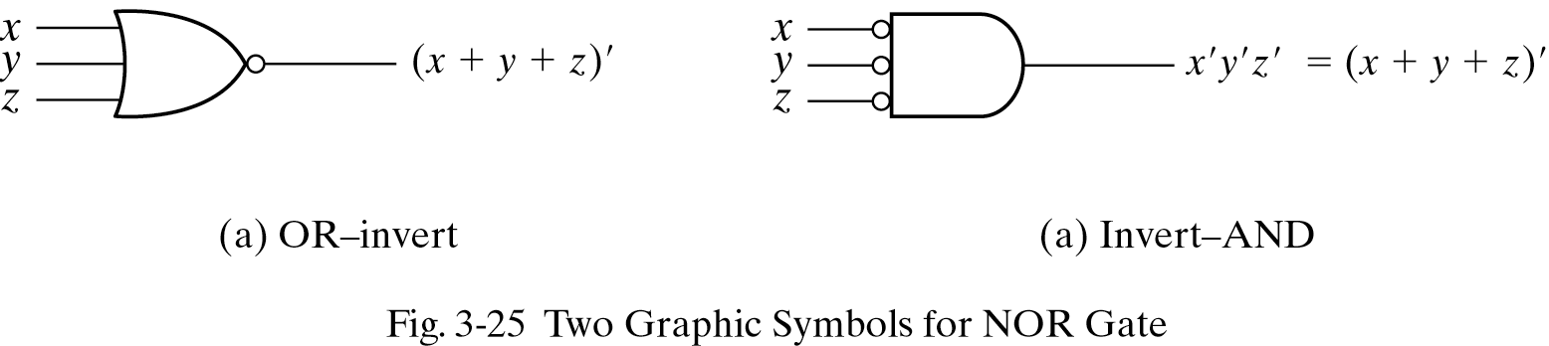
Graphical Representation of NOR Gate:
46

Slide 12
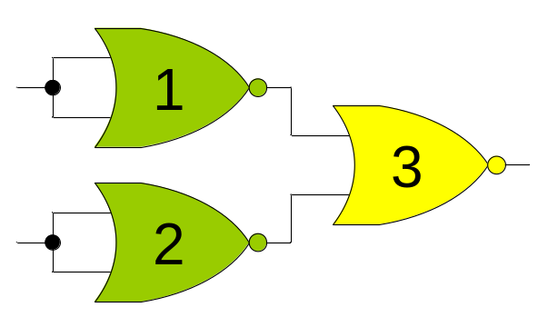
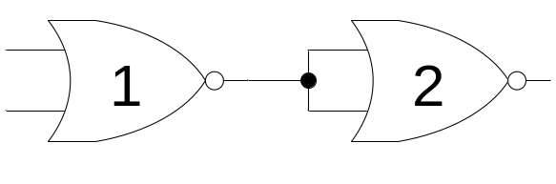
Implementation of NOT, AND and OR Gate Using NOR Gate:
NOT Gate
AND Gate
OR Gate
47

Slide 13
NOR: 2 Level Implementation Procedure:
Simplify the function and express it in POS.
Draw the NOR gate for each sum term.
Draw the single gate using OR-invert or invert-AND symbol for product term.
A term with single literal, complement if needed.
48

Slide 14
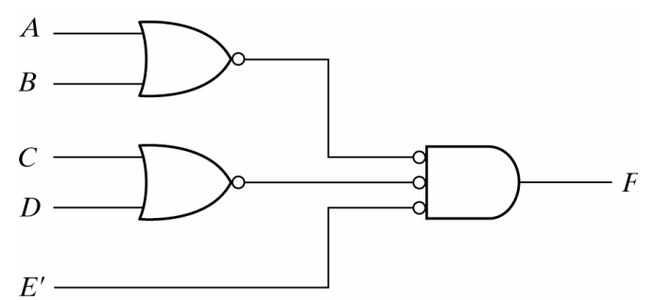
Example:
F= (A+B)(C+D)E
49

Slide 15
Multilevel NOR Circuits
Represent the Boolean function into multilevel AND-OR diagram.
Convert all AND gate to NOR gates with invert AND symbol.
Convert OR gates to NOR gates.
Balance all bubbles, insert inverter if needed.
50

Slide 16
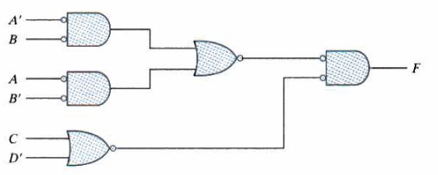
Example
F = (AB’ + A’B)(C + D’)
51

Slide 17
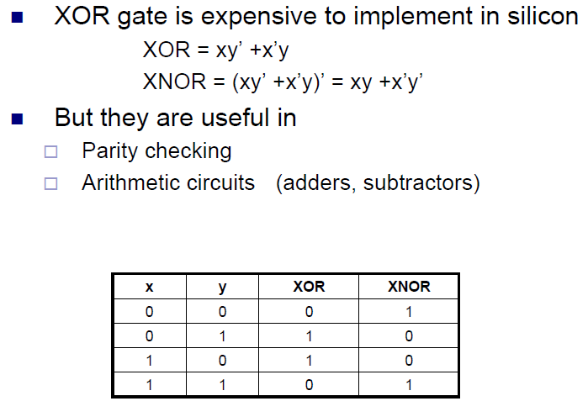

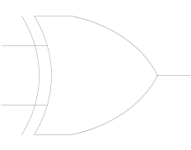
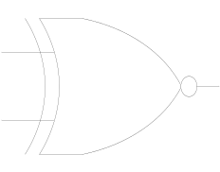
Exclusive-OR (XOR) Function
XOR
XNOR

Slide 18
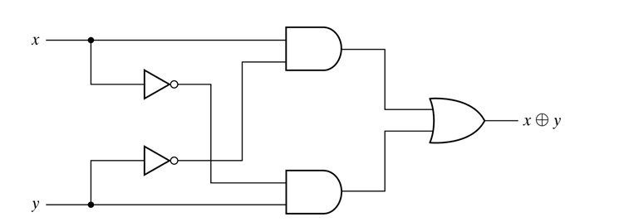
XOR Function
XOR = xy’+x’y

Slide 19


XOR Function Properties
Commutative
Associative

Slide 20

Three Variables XOR/XNOR Function.
x
0
0
0
0
1
1
1
1
y
0
0
1
1
0
0
1
1
z
0
1
0
1
0
1
0
1
F₁
0
1
1
0
1
0
0
1
F₂
1
0
0
1
0
1
1
0
XOR is odd function
XNOR is even function

Slide 21
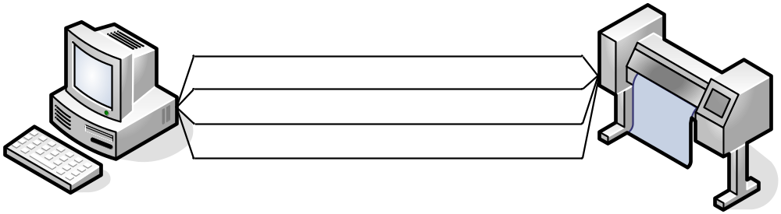
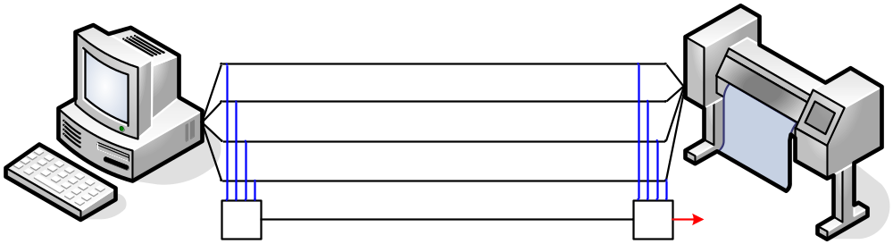
Parity Generation & Checking (Even)
1
0
1
0
1
0
1
0
1
0
0
0
✗
1
0
1
0
0
1
0
1
0
0
1
0
0
0
0
✗
✗
Parity Generator
Parity Checker

Slide 22
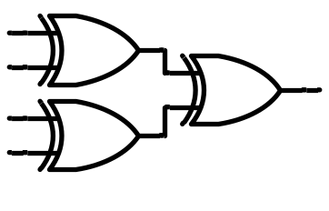
Parity Generation (Even)
1
0
1
0
1
0
1
0
0
Even number of ‘1’s

Slide 23
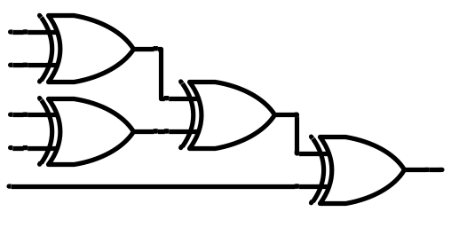
Parity Checking (Even)
1
0
1
0
0
Error
Check

Slide 24
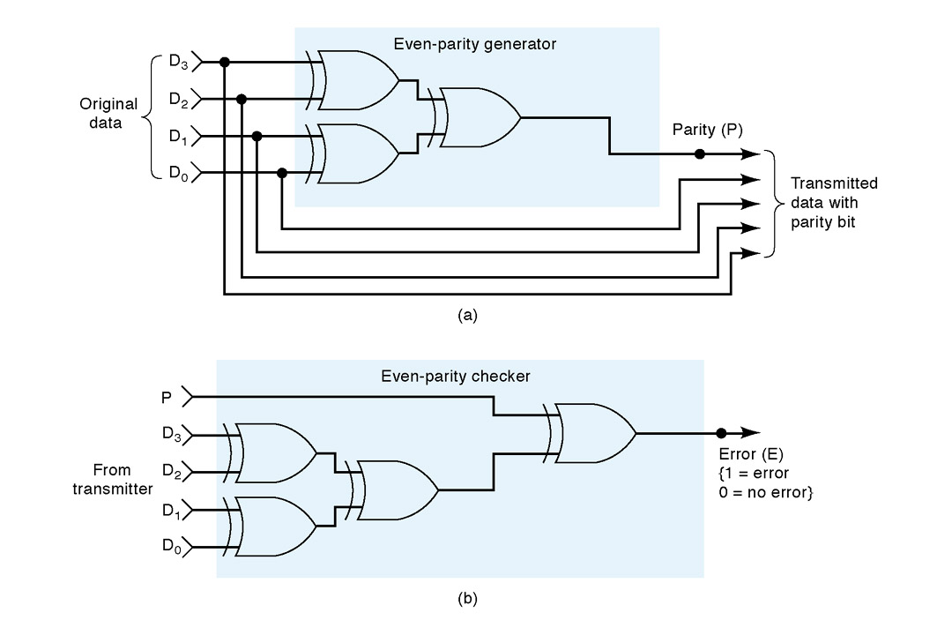
Overall Picture (Even Parity)
Transmitter (TX)
Receiver (RX)

